Slide 1
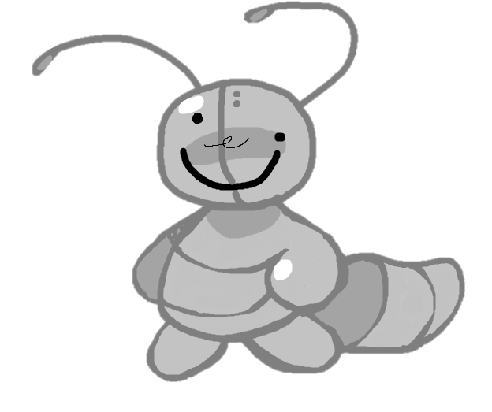
B.O.B
Bringer Of Balance.

Slide 2
The Story so Far…
One day the Queen ant decided she wanted a rave, but she was a bit lack lustre and decided to eat the entire supply of sugar.
She then demanded the worker ants to collect more, unbeknownst to her workforce was already fatigued to carry out the command.
Upon hearing this news the Queen was raging, and stormed her way to the lab and demanded the scientists create a worker bot to collect the much need sugar.

Slide 3
After many hours of hard labour….
B.O.B was created, and sent out on his first mission.

Slide 4
Then disaster struck!
A thunderstorm stuck B.O.B which caused a malfunction in his circuitry, and the functions he was left with were forward and sideways movement. The scientist ants were worried because they had lost all control.
Dedicated to the mission he carries on without the help of the scientists.

Slide 5
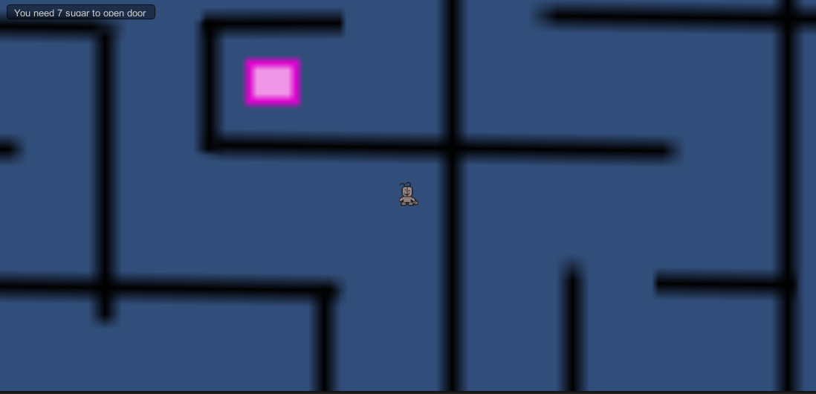
Game Objectives
Collect enough sugar using W/A/S/D in order to return back to the hive.
The door will unlock when you have collected enough.

Slide 6
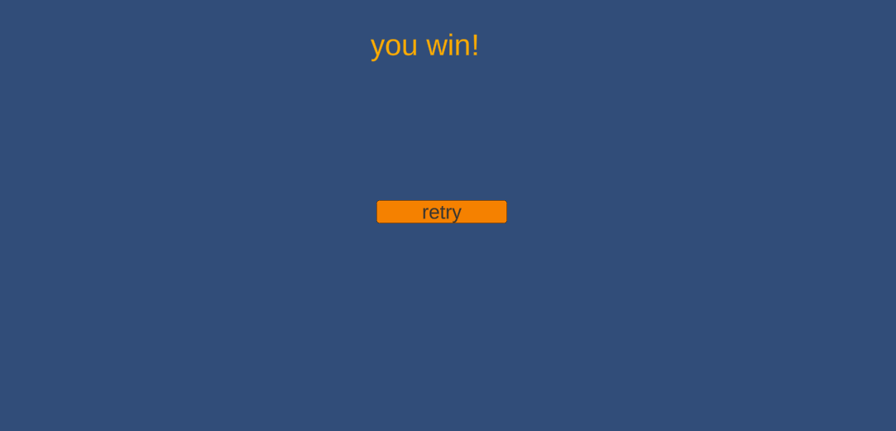
More Game Images

Slide 7
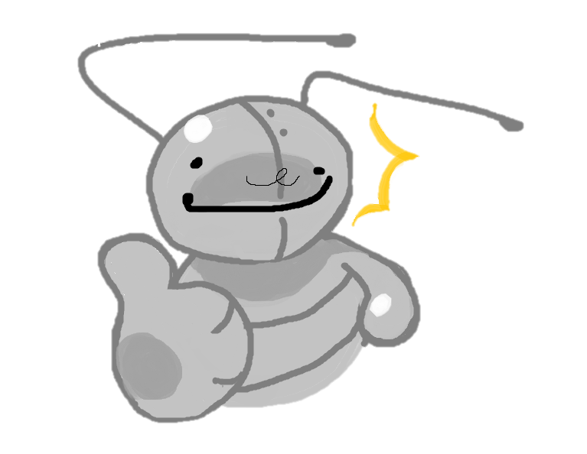
Thanks For Playing!

